Slide 1
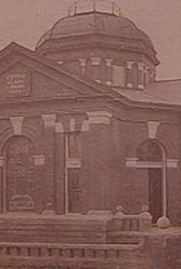
The Dr. Eugene Clark Library
The oldest continuously operating library in the State of Texas

Slide 2

Dr. Eugene Clark Library
Dr. Eugene Clark was a physician who lived in Lockhart, TX from 1883-1892. Upon his death in 1898, his will bequeathed $10,000 to build a library in his adopted city. Construction began in 1899 and on July 6, 1900, the library was formally dedicated.
Then, as now, the lie library serves as the cultural and literary center of Lockhart and Caldwell County.

Slide 3
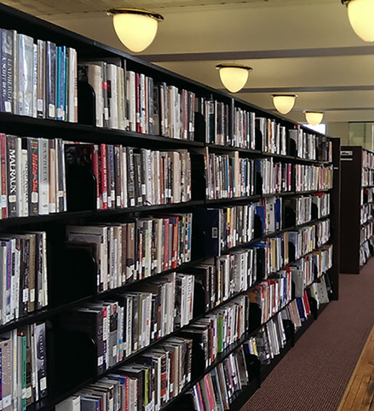
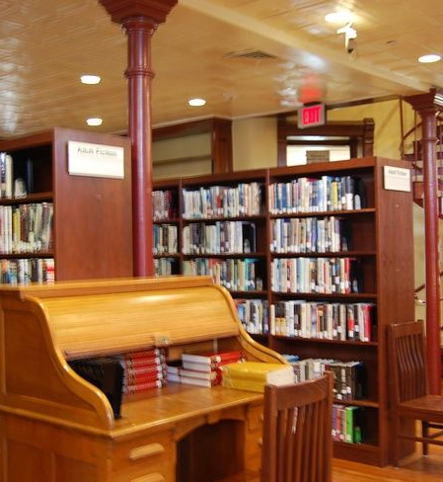
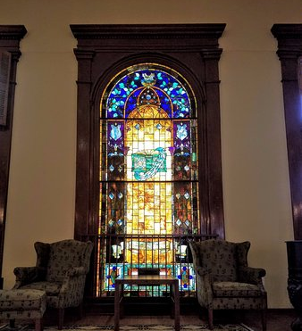
Dr. Eugene Clark Library

Slide 4




New Releases

Slide 5

Preschool Storytime*
*Storytime is now virtual! Visit the library webpage: clark-library-lockhart.org
Join us for a story and a craft
Wednesdays @ 10 am
Bilingual Thursdays @ 10 am

Slide 6
Add Computer class flyer

Slide 7

Adult craft night
Adult Craft Night Every Last Thursday of the month @6:30 pm
Don’t have a babysitter? No problem! Entertainment will be provided for the children in the children’s area of the library.

Slide 8

Evening with the songwriter free to the public! Last Tuesday of every month

Slide 9

Overdrive
Read eBooks
Best seller authors. New release titles. Classics and crowd pleasers. Your local library’s digital collection has it all. Find your next book and start reading. Download the app today!

